Slide 1

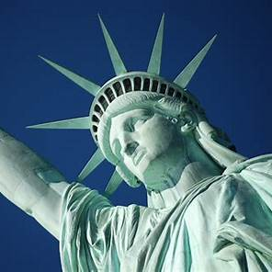

Liberty Island, New York City
STATUE
OF
Confidential – For Educational Use Only
LIBERTY
The iconic of the United States
01
02
03
History
Symbolism
Travel hints
Notes:
Goodmoring everyone. Today I’ll talk about the iconic of the U.S. it’s Statue of liberty . It located in Liberty Island , NY CT.
It’s very famous . People in the world come to take memory photos and learn sth about this statue.
Before we kno

Slide 2
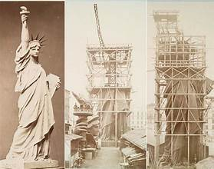
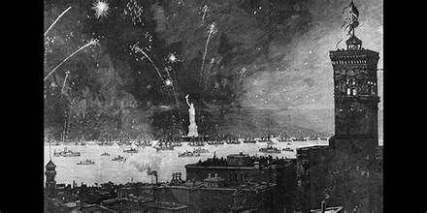
START DATE AND CONSTRUCTION PROCESS
1865
INITIAL IDEA
DESIGN AND COMMENCEMENT
1875
Confidential – For Educational Use Only
1884
COMPLETION IN FRANCE
TRANSPORTATION TO THE UNITED STATES
1885
ASSEMBLY AND INAUGURATION
1886
Notes:
About History. Here is the start date and construction process.
In 1865 the French historian uy đoa đề lé pô lêy proposed gifting a statue from the people of France to the United States to commemorate the friendship between the two nations and to honor liberty and democracy(đề mó ra xy). French sculptor Frédéric Auguste Bartholdi (v rế đê ríc- u gụt- bát thô ri) began designing the statue and started in 1875.
1884 It was completed in France after 9 years and the Pedestal was constructing in the Liberty Island in 1883 and done after 3 years
The statue was disassembled (dis sơ sém bồ) into 350 pieces and shipped to New York, arriving on June 17, 1885.
The assembly of the statue atop the pedestal was completed in October 1886. The official dedication ceremony took place on October 28, 1886, attended by U.S. President Grover Cleveland.

Slide 3

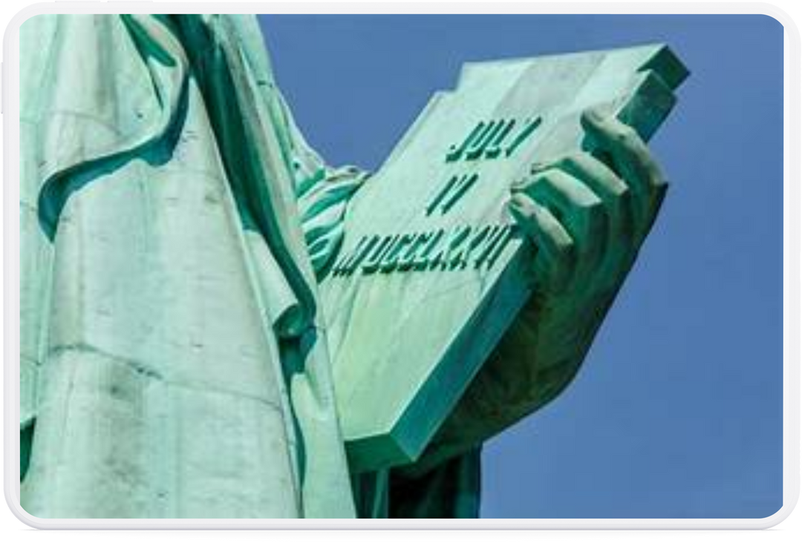
SYMBOLISM
SYMBOL OF FREEDOM AND DEMOCRACY
WELCOMING IMMIGRANTS
FRIENDSHIP BETWEEN FRANCE AND THE UNITED STATES
LIGHT GUIDING THE WAY
Confidential – For Educational Use Only
BREAKING THE CHAINS OF OPPRESSION
THE DATE OF THE DECLARATION OF INDEPENDENCE
Notes:
The Statue of Liberty, officially named "Liberty Enlightening the World," represents for the freedom and democracy in the world
the statue became a welcoming symbol for millions of immigrants arriving in the United States in search of a better life. The “America Dream”.
The statue is a gift from the people of France to the United States, commemorating the friendship and cooperation between the two nations during the American Revolution
The torch that Lady Liberty holds symbolizes the light guiding the way to freedom and knowledge. It represents enlightenment and the hope for a brighter future.
At the foot of the statue is a broken chain, symbolizing liberation from oppression and slavery. This emphasizes(ím phơ size sịt) the importance of freedom and equal rights for all. Lady Liberty holds a tablet inscribed the date of the United States Declaration of Independence. This symbolizes the foundation of freedom and democracy in the U.S.

Slide 4

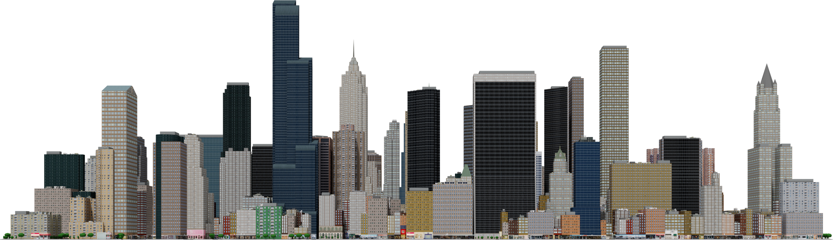
TRAVEL HINT
Confidential – For Educational Use Only
Go to the Official Ferry Service
Enjoy your trip
Purchasing Tickets
Pass Security
Notes:
There are several suggest for visitors. Because it’s just open from 8:30 AM to 4 PM and many visitor want to come there. I suggest that you should buy tickets online. Besides, there are 3 kind of tickets.” General Admission” Pedestal Reserve Ticket” Crown Reserve Ticket” Ferry service to Liberty Island and Ellis Island, access to the grounds and museums on both islands. Everything in general admission plus access to the pedestal. All pedestal access benefits plus entry to the crown. It very limited ticket. So you maybe wait for months.
There are few restaurants and public restrooms . So you don’t need to worry about these problems
Finally. Remember to check the schedule and weather. Keep safety and enjoy your trip.

Slide 5

Confidential – For Educational Use Only
Notes:
Thanks everyone for listening

